Slide 1
Immersive Python Workshop Day 2 | Git & GitHub

Slide 2
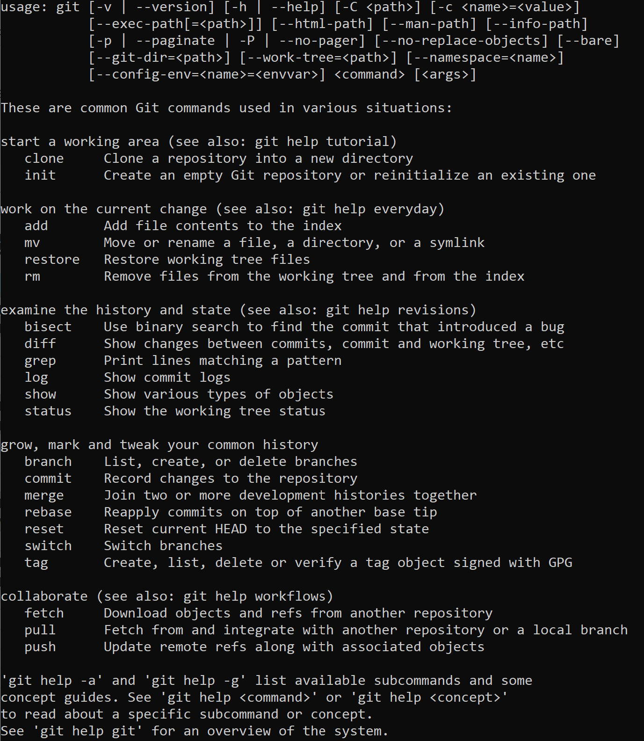
Introduction to Git
https://git-scm.com/downloads
Distributed version control system
Free and open source
Cross platform compatible
Run via Terminal or Command Prompt

Slide 3
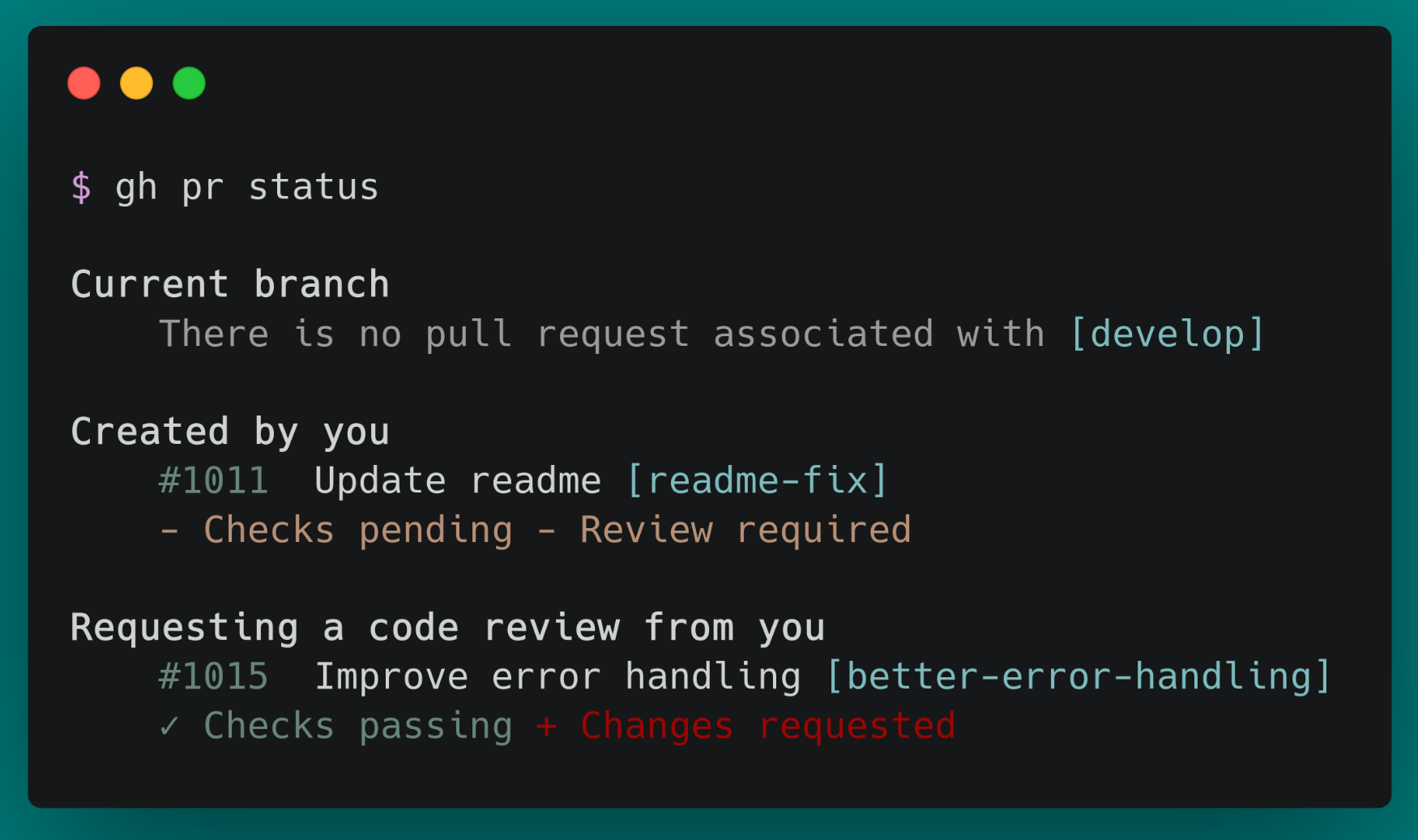
Ways to interact with Git
Command line (CL/CLI)

Slide 4
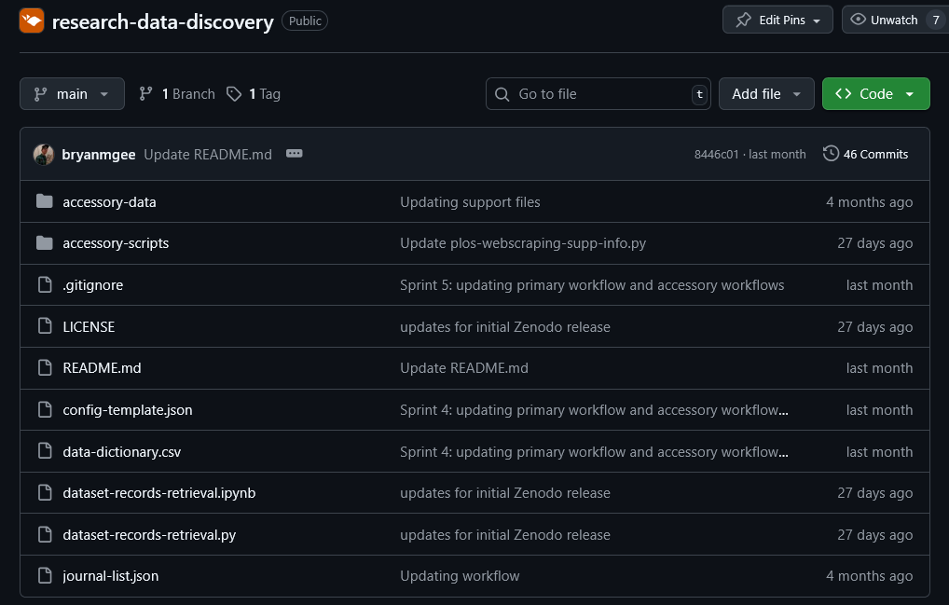
Ways to interact with Git
Web interface

Slide 5
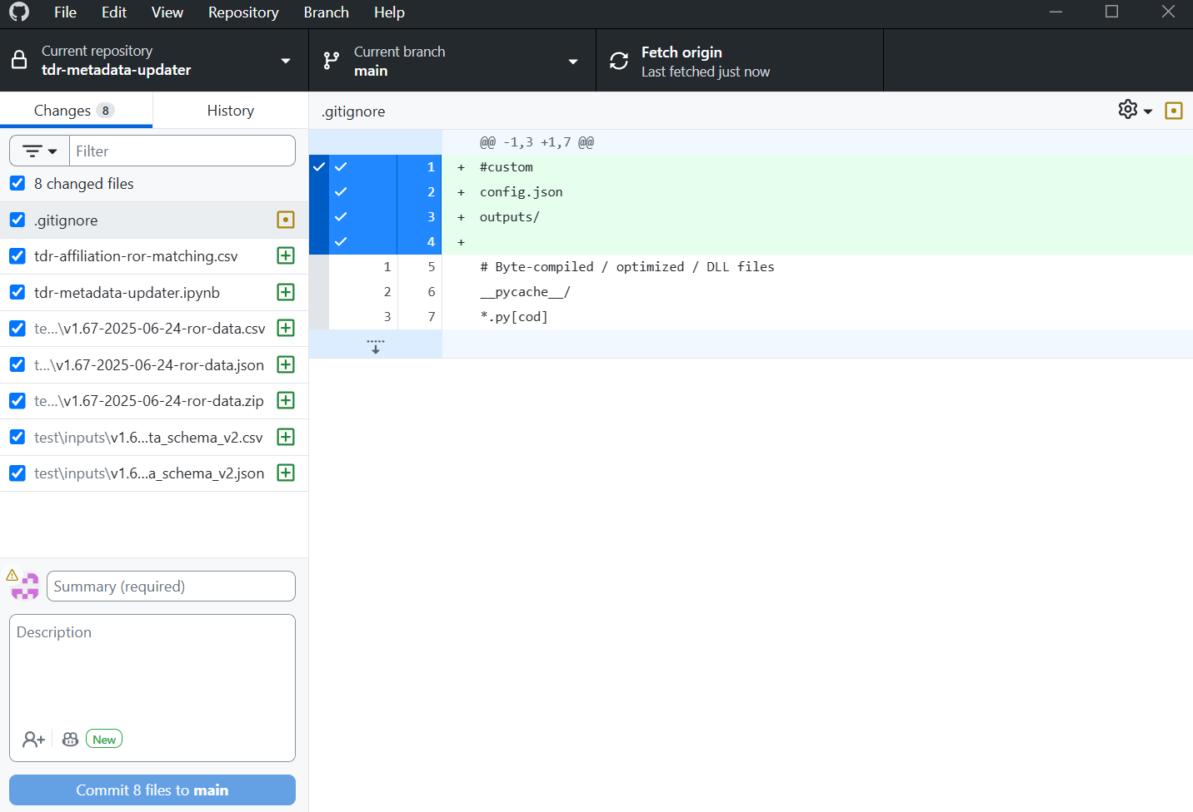
Ways to interact with Git
Graphical user interface (GUI)

Slide 6
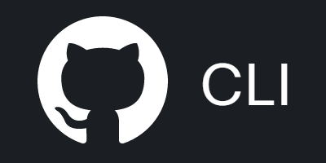









Ways to interact with Git
Software development products
Software development platform
Git framework

Slide 7


Introduction to GitHub
GitHub is a great platform for backing up, versioning, collaborating on, and sharing code
It can be a great tool for researchers who want to make their work transparent and replicable
http://github.com vs. http://github.austin.utexas.edu/ (for faculty & staff)
You can use GitHub to release code for your own projects or to contribute to other software projects that have been released as open source

Slide 8

Why Push Research Code to GitHub
Get recognition for your coding work
Share your work with others so that your code can have a greater impact
Make code backups, versioning, and publishing relatively easy
Potentially benefit from others finding bugs and submitting pull requests for code improvements
Help make your research workflows reproducible
Enterprise GitHub and private repositories allow for secure and controlled code management

Slide 9

GitHub Terminology to Know
Git Open source software used to track and manage versions of files containing text
Repository A container for all of a project’s files, they can be public or private
Commit An individual change to a set of files in a repository
Versioning Tracking and saving records of changes to files over time
Pull Request Proposed changes to a files in a repository that can be accepted or rejected
ReadMe file A file that defines the content on the repo landing page and provides essential project info
Git Ignore file A file in a git repository that describes files which should not be shared publicly

Slide 10
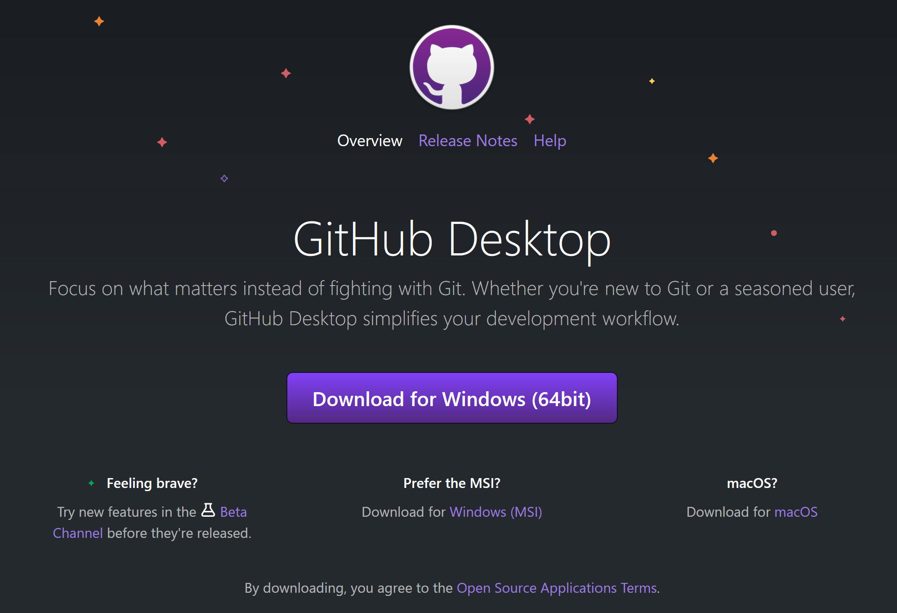
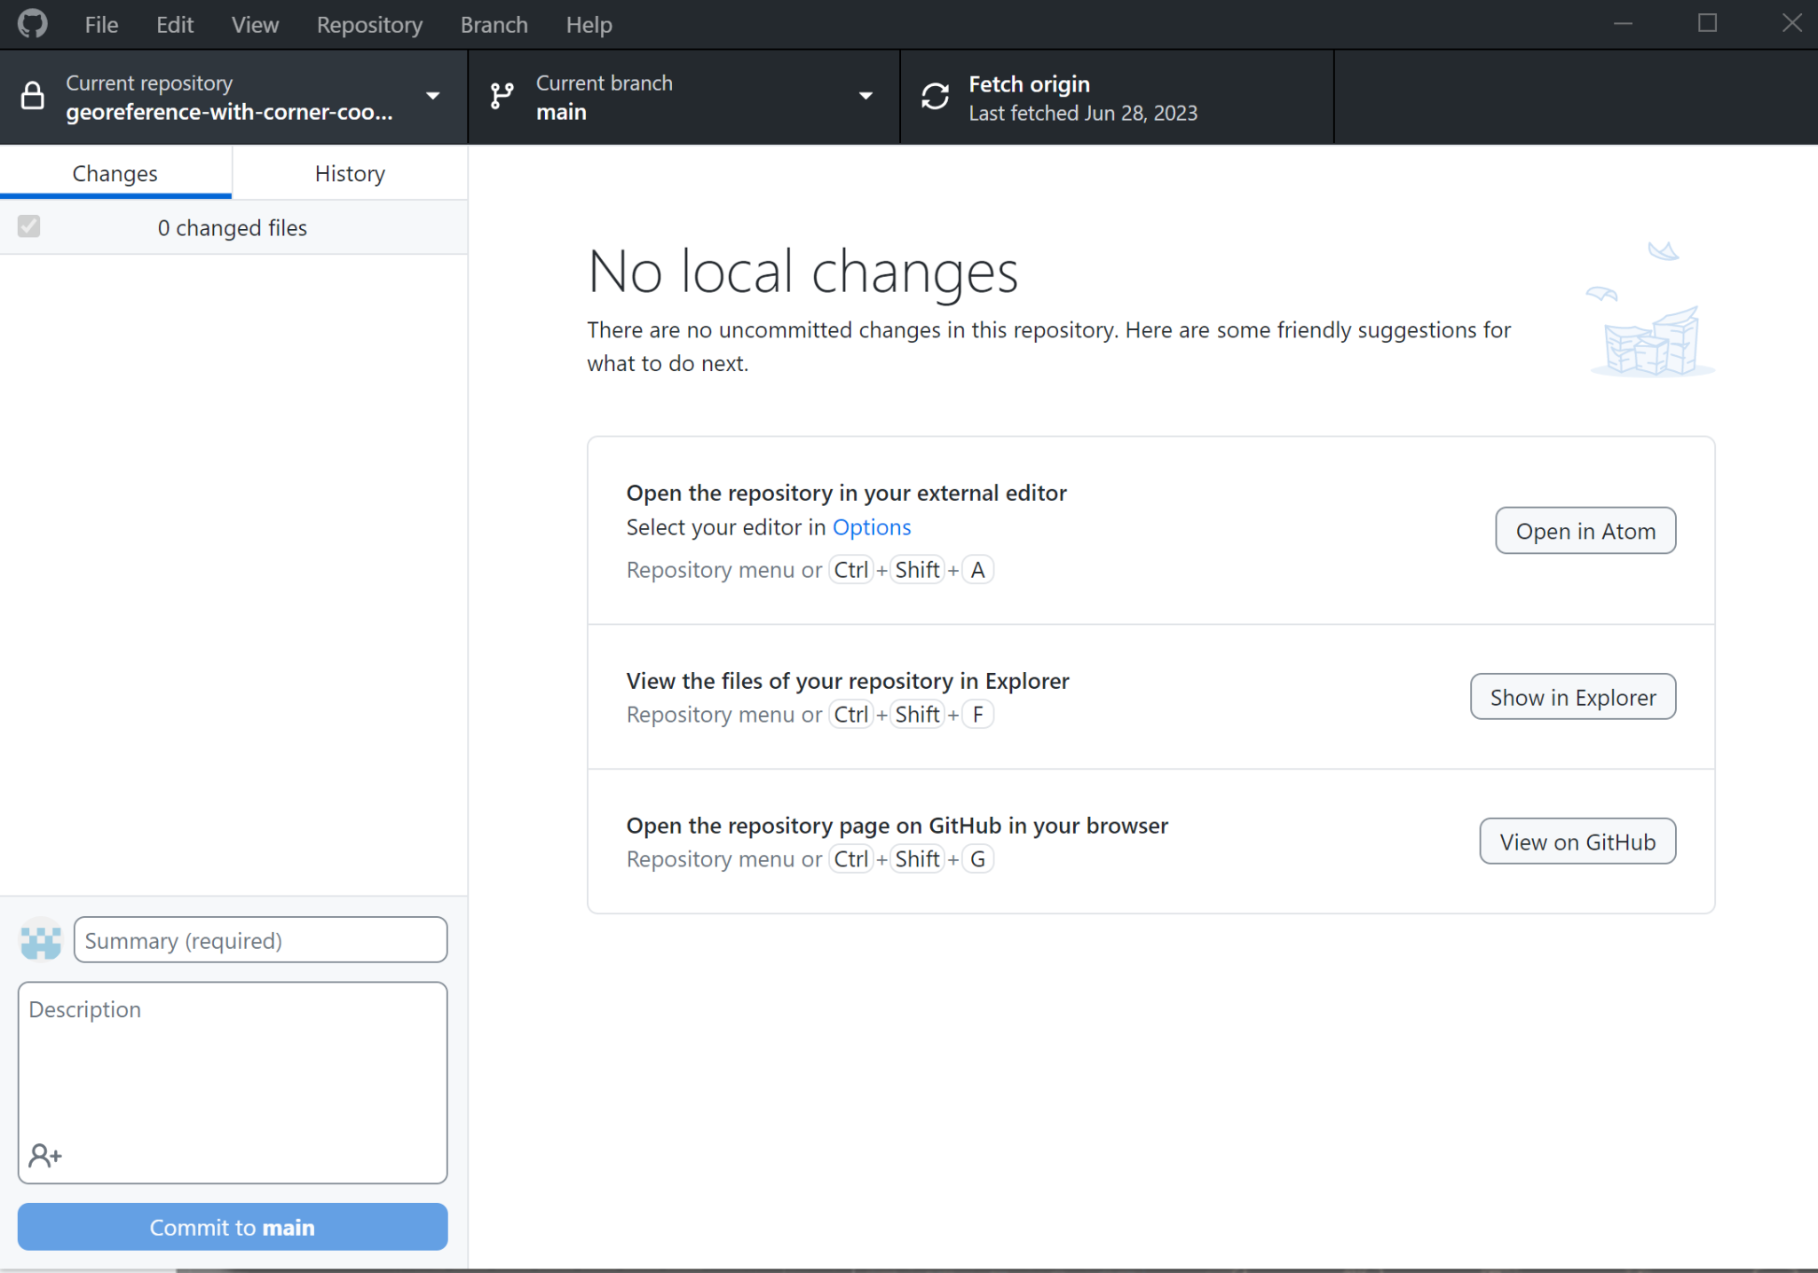
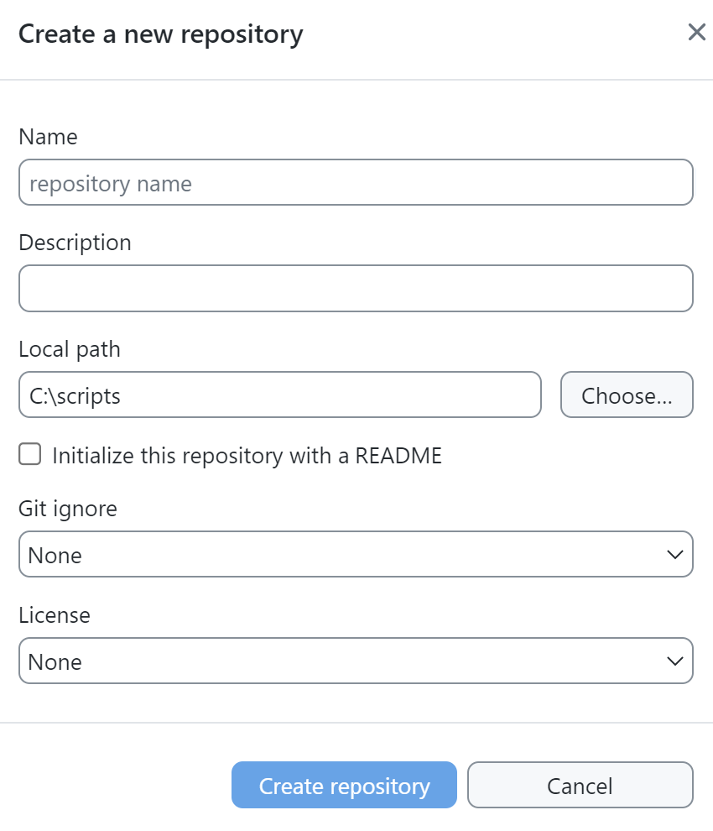
Getting Started with GitHub
Create a GitHub account
Download and install GitHub Desktop (already on lab computers)
Create a new repository in GitHub
Connect GitHub Desktop to your personal GitHub and clone the new repository created in step 3 down to your computer
Copy your Python script file that you created earlier today and past it into the repository on your computer
Make an initial commit using GitHub Desktop
Push the code from your local repository to your GitHub account

Slide 11
Other GitHub Skills to Practice
Edit .gitignore file
Fill out README file
Fork an existing open source repository
Submit a pull request

Slide 12
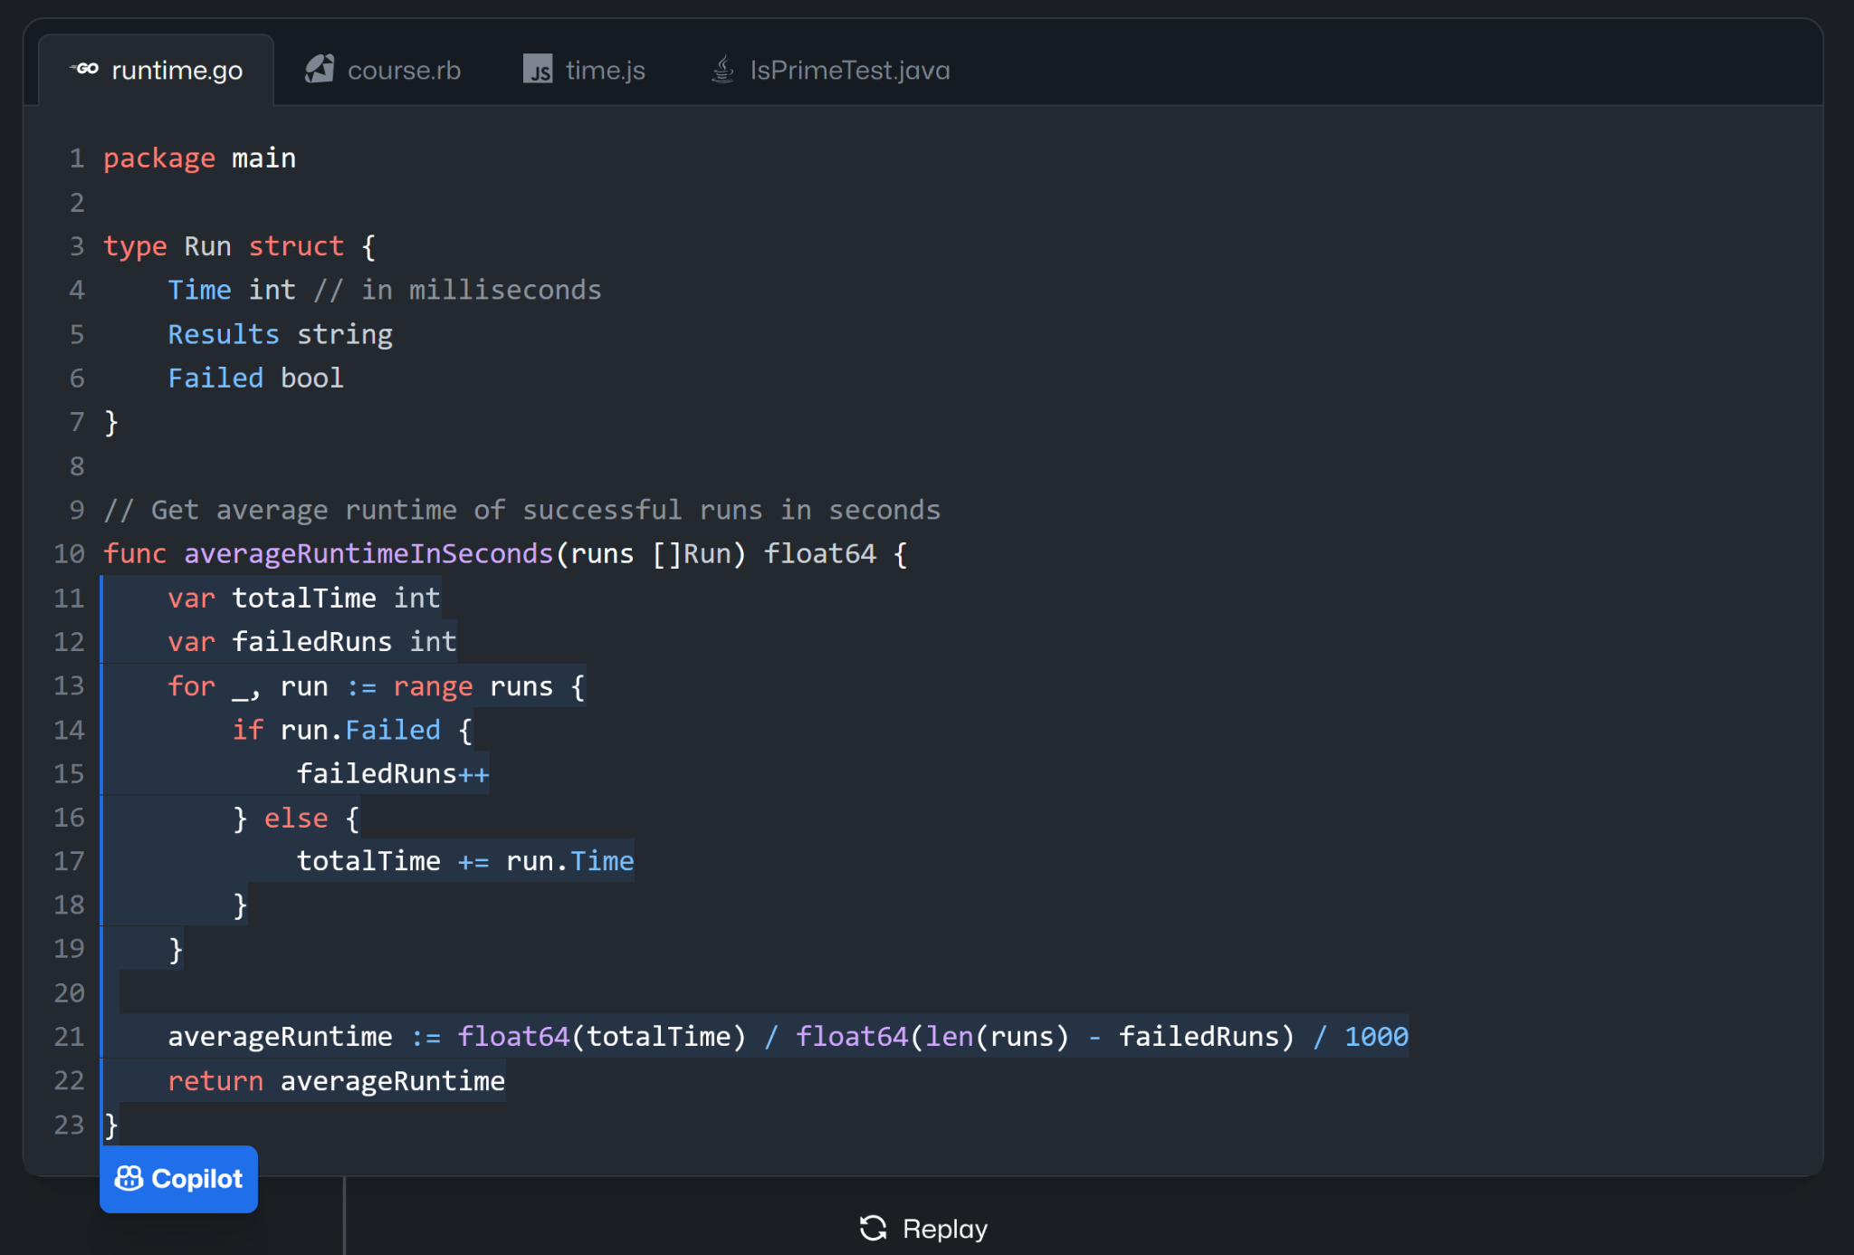
GitHub Copilot
https://github.com/features/copilot
Recently announced free tier with 50 completions per month (link)
Good for help with adding new code snippets within a project
Extension in VS Code can be used for free by students, faculty, & open source project maintainers
https://docs.github.com/en/copilot/managing-copilot/managing-copilot-as-an-individual-subscriber/managing-your-copilot-subscription/getting-free-access-to-copilot-as-a-student-teacher-or-maintainer

Slide 13



Selecting a Software Licensing
If you want others to know how they are permitted to use the code you share on GitHub, you should select a license that clearly defines associated restrictions and obligations
There are many options to choose from, but some like these below are frequently chosen
MIT
BSD 3-Clause
GPL
Apache
Visit https://choosealicense.com/licenses/ for a detailed list of license options
The open source license best practices document on the OSPO site summarizes key considerations

Slide 14





UT Open Source Program Office (UT-OSPO)
The UT Open Source Program Office (UT-OSPO) is a great resource for developers of research software
Established in 2023 with funding from the Alfred P. Sloan Foundation (Grant Number G-2023-20944)
Director: Angela Newell, Ph.D. (anewell@austin.utexas.edu)
The Office is a partnership between TACC, ITT, the iSchool, & UT Libraries

Slide 15

UT-OSPO Vision
Focus on faculty, post-docs, grad students - helping them interact with the open source communities for the tools that they use.
Engage faculty and students in an open source participation pathway advancing basic use of open source software through contribution, sharing, accepting external contributions, and ultimately developing an ecosystem of related open source projects.
Develop a community of researchers who use, contribute to or develop open source code and a program office that embraces and supports researchers at every step of the pathway from using code to developing software

Slide 16
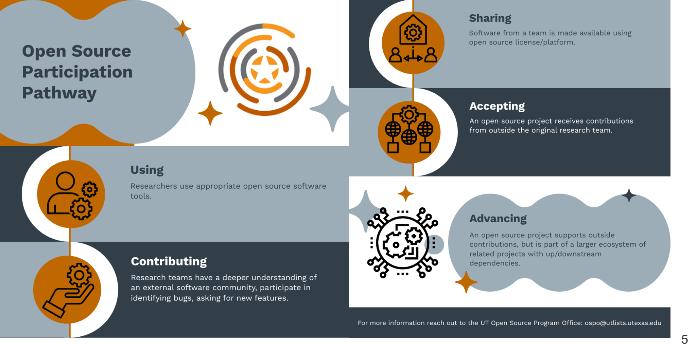

Slide 17
How Can the OSPO Help Researchers?
Training/Events
Funding Identification
Best practices guides
Consultation Services

Slide 18
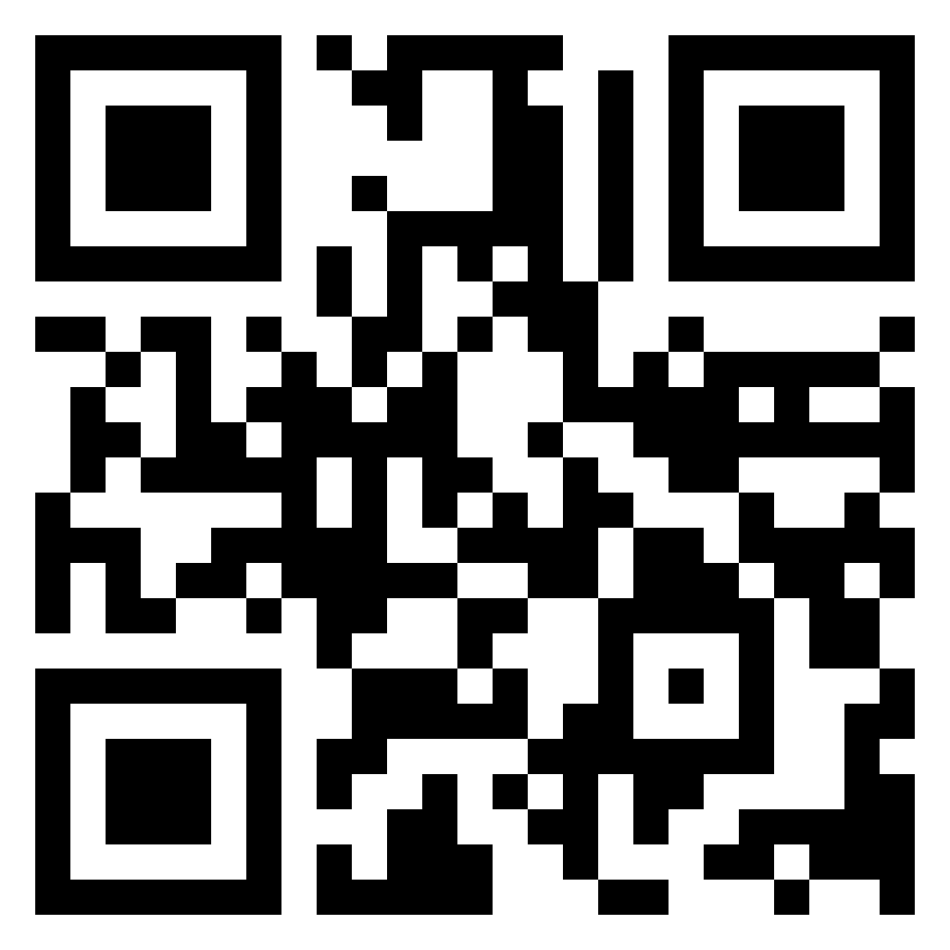
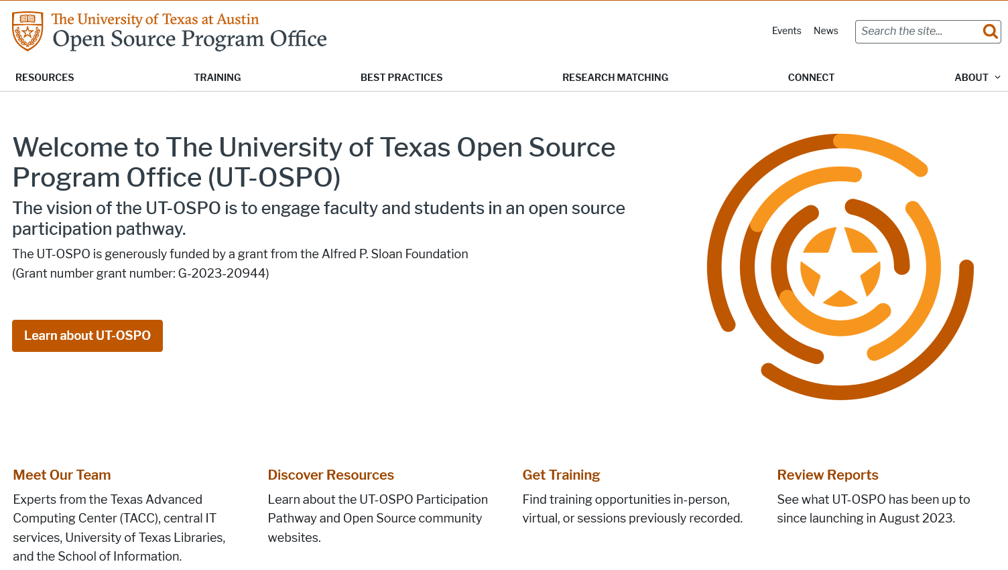
How to Connect
Contact us at: ospo@utlists.utexas.edu
Visit our website: www.opensource.utexas.edu (or use QR code below)
Sign up to receive emails: https://utlists.utexas.edu/sympa/subscribe/ospo.announce
Book a consultation: https://outlook.office365.com/book/UTOSPOOpenSourceSoftwareConsultation@utexas.onmicrosoft.com/

Slide 19
Immersive Python Workshop Day 2 | AI and coding

Slide 20
Using AI for coding
Whether using AI for coding is appropriate will depend on your personal and professional circumstances. Like any other tool, AI will be more or less useful in certain situations; can be prohibited or considered unethical in others; and is normalized to varying degrees between working groups and disciplines.
Upcoming workshop on using LLMs for generating research code
Wednesday, November 5, 2025: noon to 1 PM (Zoom)

Slide 21
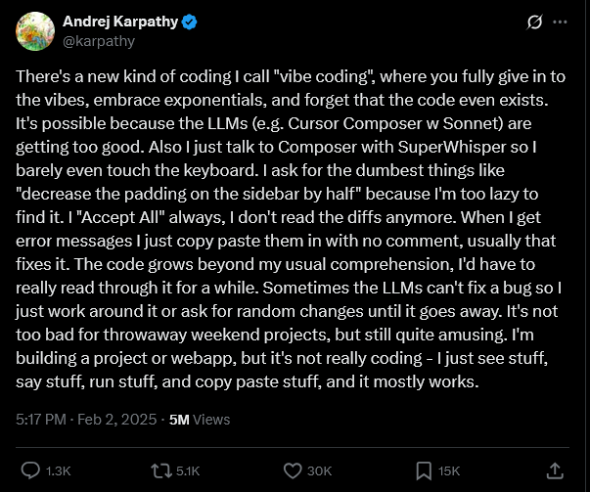
Using AI for coding

Slide 22
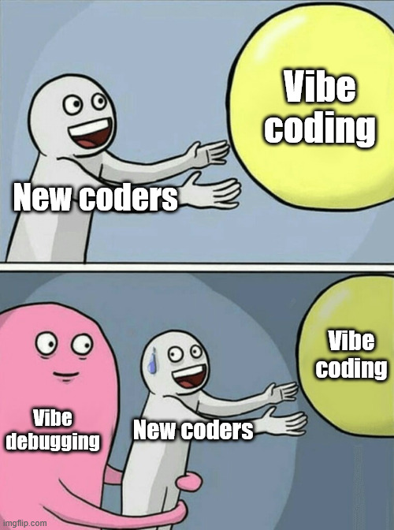
Using AI for coding

Slide 23
Considerations
Purpose of project and coding implementation
Research vs. non-research
Collaborative vs. solo
Novel vs. existing codebase
Data simulation vs. data retrieval vs. data analysis vs. data viz (etc.)
Intended usage
Generating code
Debugging code
Refactoring code
Intended tool
Security and legal policies
https://security.utexas.edu/iso-policies/cloud-services/decision-matrix#cloud-services
https://compliance.utexas.edu/prohibited-technology-and-covered-applications

Slide 24

Using AI for coding
Authors should not submit manuscripts where Generative AI tools have been used in ways that replace core researcher and author responsibilities, for example:
text or code generation without rigorous revision
synthetic data generation to substitute missing data without robust methodology
generation of any types of content which is inaccurate including abstracts or supplemental materials
Source: https://taylorandfrancis.com/our-policies/ai-policy/

Slide 25
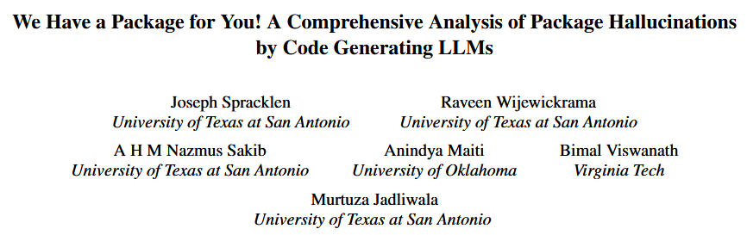
Slop-squatting
“Using 16 popular LLMs for code generation and two unique prompt datasets, we generate 576,000 code samples in two programming languages that we analyze for package hallucinations. Our findings reveal that that the average percentage of hallucinated packages is at least 5.2% for commercial models and 21.7% for open-source models, including a staggering 205,474 unique examples of hallucinated package names, further underscoring the severity and pervasiveness of this threat.”
(https://doi.org/10.48550/arXiv.2406.10279)

Slide 26
Slop-squatting
“The problem is, these code suggestions often include hallucinated package names that sound real but don’t exist. I’ve seen this firsthand. You paste it into your terminal and the install fails – or worse, it doesn’t fail, because someone has slop-squatted that exact package name. When we investigate, we sometimes find realistic looking READMEs, fake GitHub repos, even sketchy blogs that make the package seem authentic.”
"Even worse, when you Google one of these slop-squatted package names, you’ll often get an AI-generated summary from Google itself confidently praising the package, saying it’s useful, stable, well-maintained. But it’s just parroting the package’s own README, no skepticism, no context. To a developer in a rush, it gives a false sense of legitimacy.”
-Feross Aboukhadijeh (CEO of Socket)
(https://www.theregister.com/2025/04/12/ai_code_suggestions_sabotage_supply_chain/)

Slide 27
Best practices
Before using
Discuss use of AI with any collaborators, project partners, etc.
Review institutional policies on the use of AI
Review publisher policies on the use of AI (if intending to publish a journal article)
While using
Assume the LLM is naive but confident
If the LLM suggests something that seems erroneous or inappropriate, it probably is
A confident LLM is not a correct LLM
Verify all suggested packages and do not let an LLM install packages or write code to do so
Inspect results to ensure that outputs align with predictions
Incorporate recurring checks
Do not substitute LLM-assisted coding for learning a software language

Slide 28


Upcoming Fall Workshops & Events
Data & Donuts Workshop Series
What Workshops covering research data practices and software
When On the following dates: 9/5, 9/26, 10/3, and 10/24
Time 12pm - 1:15pm
Where Zoom (all dates) / PCL Scholars Lab (select dates)
More info https://guides.lib.utexas.edu/data-and-donuts
What Learn about AI tools for developing your own research software
When Wed. 11/5, 12pm - 1pm
Where Virtual
AI for Writing Research Code

Slide 29
Workshop Wrap Up
Thank you for attending!
Any questions?
Please provide Day 2 feedback in the shared notes document at https://bit.ly/ipw-aug2025
Please also fill out structured OSPO feedback form
We appreciate your feedback!

